Slide 1
Ca stone Proiect
Airbnb Bookings Analysis

Slide 2
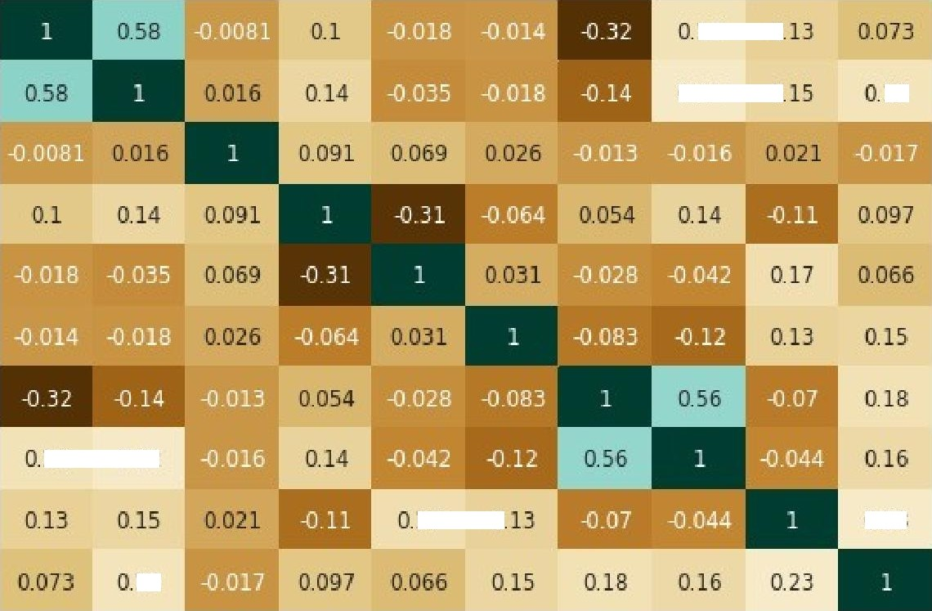




Correlation Heat Maa
Visualization
OBSERVATIONS :-
There is a moderate positive correlation (0.58) between the Host Id and Id columns, which suggests that hosts with more listings are more likely to have unique host IDs.
There is a weak positive correlation (0.17) between the price column and the Host Listings Count column, which suggests that hosts with more listings tend to charge higher prices for their listings.
There is a moderate positive correlation (0.23) between the Host Listings Count column and the avaiIabiIity_365 column, which suggests that hosts with more listings tend to have
more days of availability in the next 365 days.
There is a strong positive correlation (0.58) between the Number Of Reviews column and the Reviews Per Month column, which suggests that listings with more total reviews tend to have more reviews per month.
listing id
19 0
host_id
0.22 0
l9
Iatitude
longitude
-0.6
pI”ice
—04
miniIrum_nigIJts
total re v ie\'.'s
-02
reviews per month
19
0.22
-0.0
^{h} '-"‘^{in}k'-°^{o nt}
availability 365
17 0
023
19
- —0.2
/'
i
latitude
longitude
reviews per month
* "
E

Slide 3
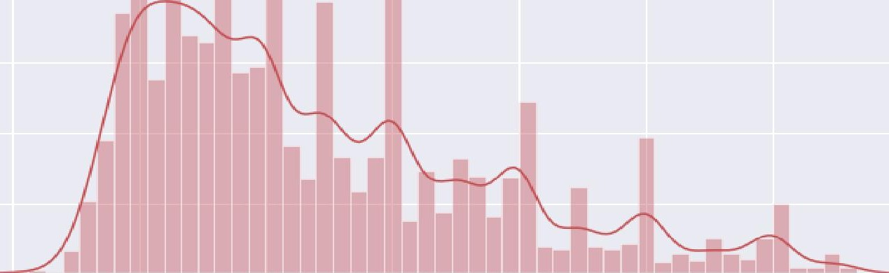
s Price Ran e Usin
Distribution Of Airbnb Bookin Histo ram
Distribution of Airbn b Prices
0.ONO
0.OO6
0.OO4
0.OO2
0.OOO
50
Price
300
OBSERVATIONS :-
The range of prices being charged on Airbnb appears to be from 20$ to 330$ , with the majority of listings falling in the price range of 50$ to 150$ .
The distribution of prices appears to have a peak in the 50 to 150$ range, with a relatively lower density of listings in
higher and lower price ranges.
There may be fewer listings available at prices above 250$ , as the density of listings drops significantly in this range.

Slide 4






Total Listin
ert Count
count in Each Nei hborhood
Neighbourhood group Listing Counts in NYC
OBSERVATIONS :-
Manhattan and Brooklyn have the highest number of listings on Airbnb, with over 19,000 listings each.
Queens and the Bronx have significantly fewer listings compared to Manhattan and Brooklyn, with 5,567 and 1,070 listings and Staten Island has the fewest number of listings, with only 365.
20 0 00
Despite being larger in size, the neighborhoods in Queens, the Bronx, and Staten Island have fewer listings on Airbnb compared to Manhattan, which has a smaller geographical area.
Ne\phbourhood_Group
This could suggest that the demand for Airbnb rentals is higher in Manhattan compared to the other neighborhoods, leading to a higher concentration of listings in this area
Alternatively, it could be that the supply of listings is higher in Manhattan due to a higher number of homeowners or property owners in this neighborhood who are willing to list their properties on Airbnb.
Manha'ttan* | 19501
Brooklyn | 19415
Queens | 5567
Bronx | 1070
Staten Island | 365

Slide 5
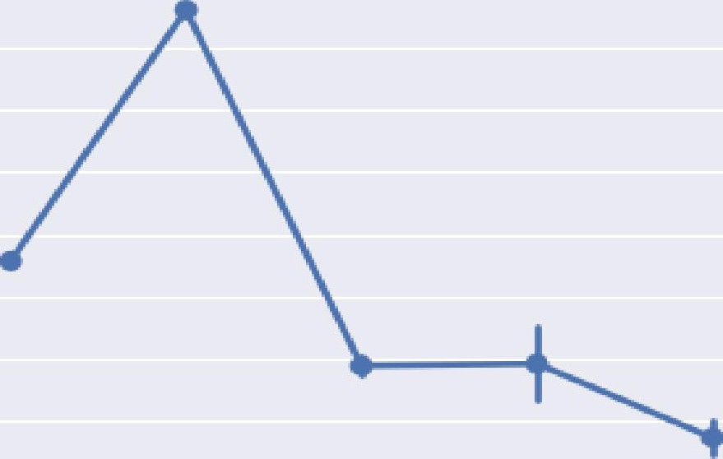
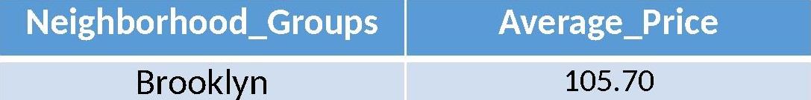
Avera e Price Of Each Nei hborhood Grou
Point Plot
OBSERVATIONS :-
The average price of a listing in New York City varies
significantly across different neighborhoods,
with Manhattan having the highest 146$/day average price and the Bronx having the lowest near 77$/day.
Averag e Pri ce by Neig hbou rhoDd Grou p
190
140
130
lZ0 110
100
9O
Average PriEe
The average price increases as you move from the outer boroughs (Bronx, Brooklyn, Queens, and Staten Island) towards the center of the city (Manhattan).
The average price in queens and Staten Island is relatively similar, despite being in different parts of the city.
The data suggests that the overall cost of living in New York City is higher in the center of the city (Manhattan) compared to the outer boroughs. This is likely due to the fact that Manhattan is the most densely populated and commercially important borough, and therefore has higher demand for housing in the centrally located neighborhoods.
8O
ELrook lyn fi•1an hatLar‹ Queens '2tamen ml anci Bra nx
Neighbourhood Group
Manhattan
145.90
Queens
88.90
89.24
Staten Island
Bronx
77.37

Slide 6


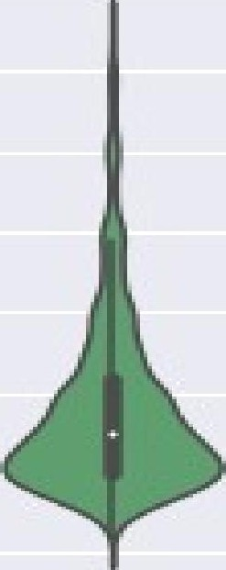


Price Distribution Of Each Nei
hborhood Grou
Violin Plot
Brool< lan F•1a n In attan Quie•en s 'Staten IsaI nd Bra nx
i g h bDLJFhaacl g rDup
OBSERVATIONS :-
price distribution is very high in Manhattan and Brooklyn. but Manhattan have more Diversity in price range, you can see in violin plot.
Queens and Bronx have same price distribution but in Queens area more distribution in 50$ to 100$ but diversity in price is not like Manhattan and Brooklyn.

Slide 7








To Nei hborhoods b Listin Ijaot
Listings by Top Neighborhoods in NYC
ert
350 0
Total Listings
Williamsburg Bedford-Stuyvesant Harlem
Bushwick
3732
3638
2585
2438
1788
1731
1714
Upper West Side Hell's Kitchen East Village
500
Neighbourhood
OBSERVATIONS :-
The top neighborhoods in New York City in terms of listing counts are Williamsburg, Bedford-Stuyvesant, Harlem, Bushwick, and the Upper West Side.
The top neighborhoods are primarily located in Brooklyn and Manhattan. This may be due to the fact that these boroughs have a higher overall population and a higher demand for housing.

Slide 8

To Hosts With More Listin ert
Bar chart
40O
top 10 hosts on the oasi s of no of listings in entire NYC!
Top Hosts | t | Total Listings
Michael |  | 383
David |  | 368
John |  | 276
Sonder (NYC) |  | 272
Alex |  | 253
Sarah |  | 221
top LD hosts
OBSERVATIONS :-
The top three hosts in terms of total listings are Michael, David, and John, who have 383, 368, and 276 listings, respectively.
There is a relatively large gap between the top two hosts and the rest of the hosts. For example, john has
276 listings, which is significantly fewer than Michael's 383 listings.
There are relatively few hosts with a large number of listings. This could indicate that the Airbnb market is relatively competitive, with a small number of hosts dominating a large portion of the market.

Slide 9

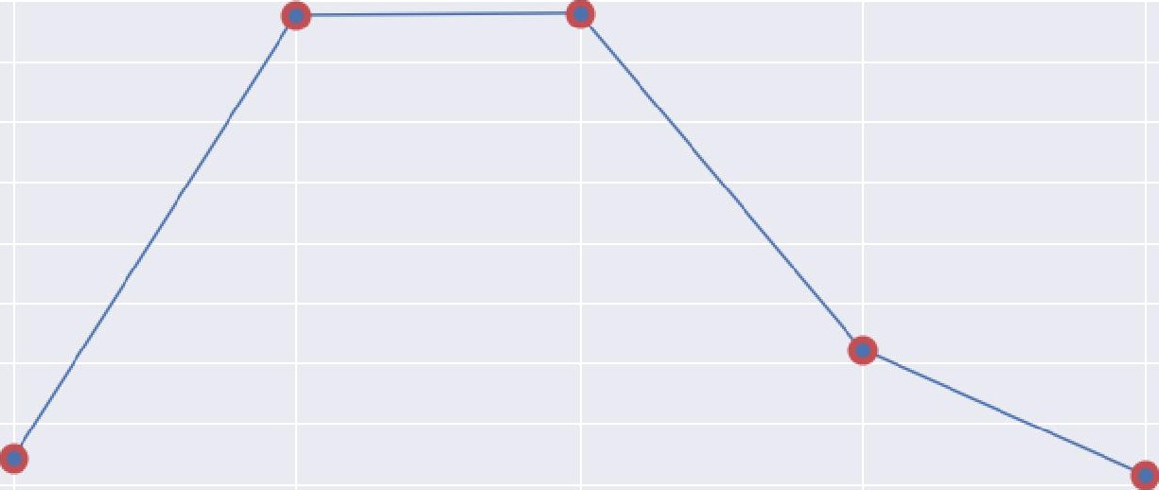
Number Of Active Hosts Per Location Usina Line
Chart
Number of Active Hosts per Location
20000
17500
Number o* Active Hosts
15000
Manhattan Brooklyn Queens Bronx
Staten Island
19501
19415
5567
1070
365
11500
10000
7500
5000
1500
0
Brook Iy n
£Yanh attan
Location
Oueems
Staten Island
OBSERVATIONS :-
Manhattan has the largest number of hosts with 19501,BrookIyn has the second largest number of hosts with 19415.
After that Queens with 5567 and the Bronx with 1070. while Staten Island has the fewest with 365 Hosts.
Brooklyn and Manhattan have the largest number of hosts, with more than double the number of hosts in Queens and more than 18 times the number of hosts in the Bronx.

Slide 10
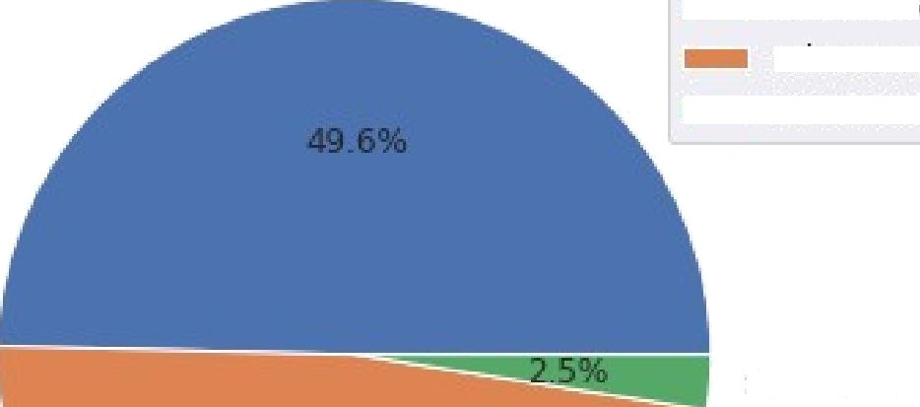
Total Counts Of Each Room Tveqens in
me Nvc
Usinq i_Pie
Chart
 | Room Types | Total Counts
 | Entire Home/Apt | 22784
 | Private Room | 21996
 | Shared Room | 1138
Entire home/apt
Room Type Entire home/apt Private room Shared room
OBSERVATIONS :-
The majority of listings on Airbnb are for entire homes or apartments, with 22784 listings, followed by private rooms with 21996 listings, and shared rooms with 1138 listings.
There is a significant difference in the number of listings for
each room type. For example, there are almost 20 times as
5IaarecI room
many listings for entire homes or apartments as there are for
shared rooms.
The data suggests that travelers using Airbnb have a wide range of accommodation options to choose from, including private rooms and entire homes or apartments
Private room

Slide 11
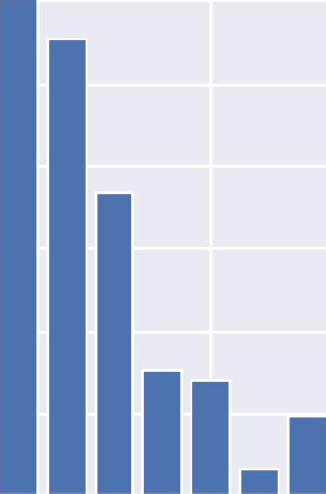
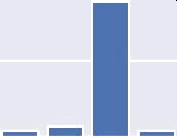
Re uirement counts b Minimum Ni hts usin Bar chart
Stay Requirement by Minimum Niphts
12000
10000
BOOO
600 0
400 0
ZOOO
0
Count
0
5
10
15
minimum Nights
20
25
30
OBSERVATIONS :-
The majority of listings on Airbnb have a minimum stay requirement of 1 or 2 nights, with 12067 and 11080 listings, respectively.
The number of listings with a minimum stay requirement decreases as the length of stay increases,
with 7375 listings requiring a minimum stay of 3 nights, and so on.
There are relatively few listings with a minimum stay requirement of 30 nights or more, with 3489 and 189 listings, respectively.

Slide 12

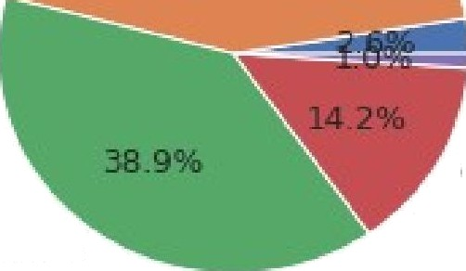
Total Reviews b
Each Nei hborhood Grou
Pie Chart
OBSERVATIONS :-
Brooklyn has the largest share of total reviews on Airbnb, with 43.3%, followed by Manhattan with 38.9%.
Queens has the third largest share of total reviews, with 14.2%, followed by the Bronx with 2.6% and Staten Island with 1.0%.
The data suggests that Airbnb is more popular in Brooklyn and Manhattan compared to the other neighborhood groups.
Despite having fewer listings, Brooklyn has more reviews on Airbnb compared to Manhattan. This could indicate that Airbnb users in Brooklyn are more likely to leave reviews, or that the listings in Brooklyn are more popular or successful in generating positive reviews. It is worth noting that there could be a number of other factors that could contribute to this difference in reviews, such as the quality of the listings or the characteristics of the travelers who use Airbnb in these areas.
Num be r of Revi ews by Neig nbDrh DOd Group in New York City
Brook lyn
@OP3
Staten Island
Queen s
fi•1anhattan

Slide 13
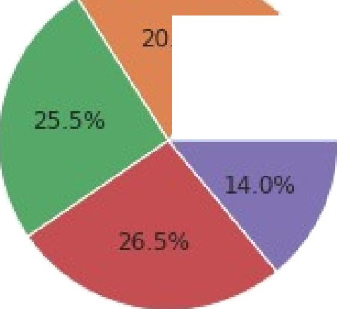
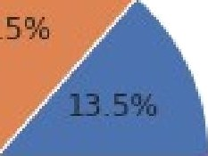
Number of Max. Reviews bv Each Nei hborhood Grou usinq i_Pie Chart
OBSERVATIONS :-
Queens and Manhattan seem to be the most popular neighborhoods for reviewing, as they have both high number of maximum reviews.
Queens has the highest percentage of reviews at 26.5%, but it has the third highest number of listings, behind Manhattan and Brooklyn. This suggests that Queens may be a particularly popular destination for tourists or visitors, even though it has fewer listings compared to Manhattan and Brooklyn.
Manhattan and Brooklyn also have a high percentage of reviews, at 25.5% & 20.5%. This indicates that it is a popular destination for tourists or visitors as well... (number of listings higher than queens).
Overall, this data suggests that Queens, Manhattan, and Brooklyn are the most popular neighborhoods for tourists or visitors, based on the high number of reviews they receive.
Number of maximum Reviews by Neiqhborhood Group in NYC
Brooklyn
Bronx
ManhattaM
Staten Island

Slide 14

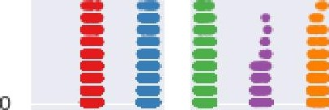
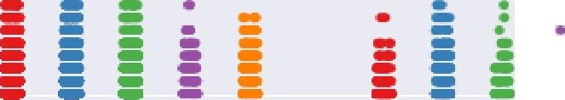
Most Reviewed Room Tvne Per Month In Neighborhood
orouDS
OBSERVATIONS :-
Most Reviewed room types in each Ne\gt1bourhood Groups
r °ighbourhood group
60
We can see that Private room received the most no of reviews/month where Manhattan had the highest reviews received for Private rooms with more than 50 reviews/month, followed by Manhattan in the chase.
G htanhattan
€ CXseens
G '2taten Island e Bronx
50
40
Manhattan & Queens got the most no of reviews for Entire home/apt room type.
30
There were less reviews received from shared rooms as compared to other room types and it was from Staten Island followed by Bronx.
20
10
Privare room
E nti re home/apt FDDP0_ty pe
'2la are cJ room

Slide 15





OBSERVATIONS :-
Manhattan has more listed properties with
count of each room types in entire NYC
Entire home/apt around 24.6% of total listed properties followed by Brooklyn with around 19.5%.
Private rooms are more in Brooklyn as in 21.9% of the total listed properties followed by Manhattan with 16.9% of them. While 7.3% of private rooms are from Queens.
Very few of the total listed have shared rooms listed on Airbnb where there's negligible or almost very rare shared rooms in Staten Island and Bronx.
We can infer that Brooklyn,Queens,Bronx has more private room types while Manhattan which has the highest no of listings in entire NYC has more Entire home/apt room types.
Private room
24.6^{O}%
E iltire home/apt
neighbourhood group
Brook lyn
£4anhattan
@ueen s
Staten IsIand Bronx
5In a reel room
4X
)0lW
0
2000
4 OOO
6000
B000
10000
RoOM CDU nf5

Slide 16
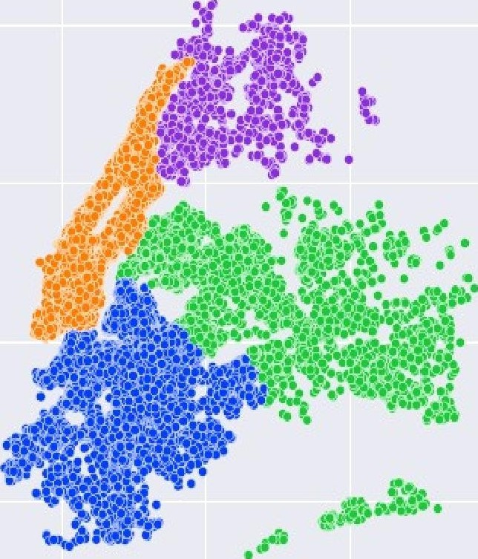
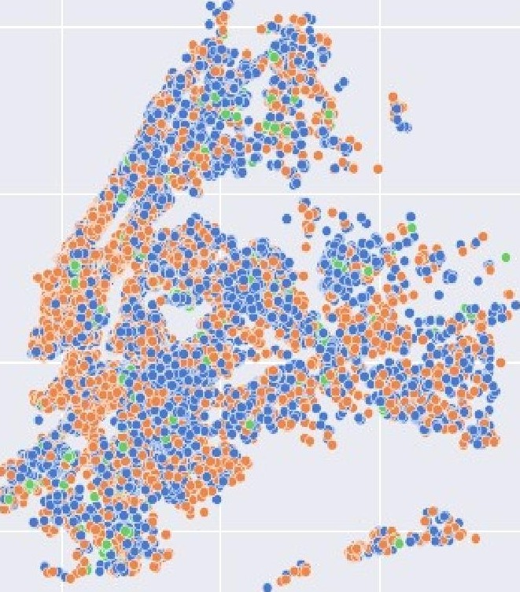

Distribution Of @OOI13
Tvaes Across NYC
Location Co-ordinates
Distribution of type of roams across NYC
neighbourhood group
ioom type
Private room. Entire home/a’pt Bhared room
40.9
y £ ooMyn
' l'4anhattan
e Queens
o Staten Island
O Bronx
40.9
40.8
latitude
b õ tude
-74.2 | -74.1 | -740 | -7Z9 | -73.8 | -73.7 | -7B2 | —7 4. 1 | -74.0 | —73.9 | -73.8 | —73.7
 |  | bngitude |  |  |  |  |  | longitude

Slide 17
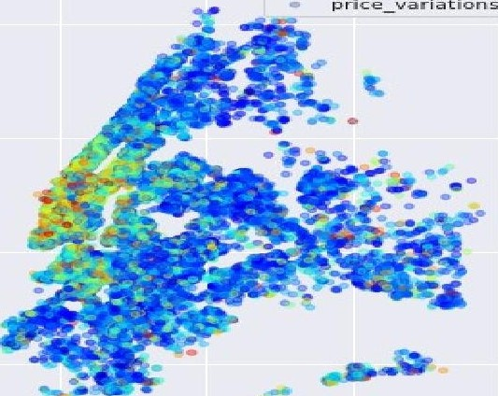

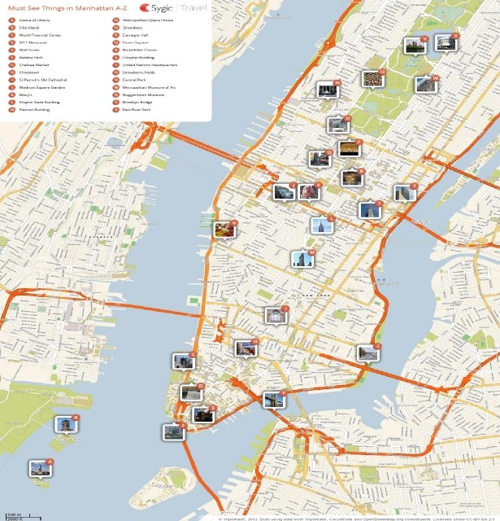
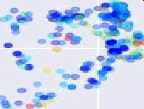

Price variations in NYC Nei
”scatter
hborhood
OBSERVATIONS :-
The range of prices for accommodations in Manhattan is particularly high, indicating that it is the most expensive place to stay in NYC due to its various attractive amenities, as shown in the attached image
They are likely to attract a lot of tourists or visitors because of more valuable things to visit so price is higher than other neighborhood groups. Travelers are likely to spent more days in this area because of popular amenities, high concentration of tourist attractions and public transports.

Slide 18
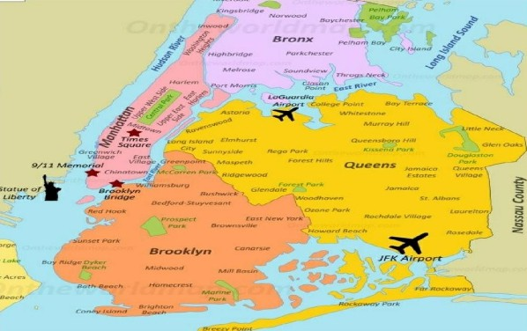
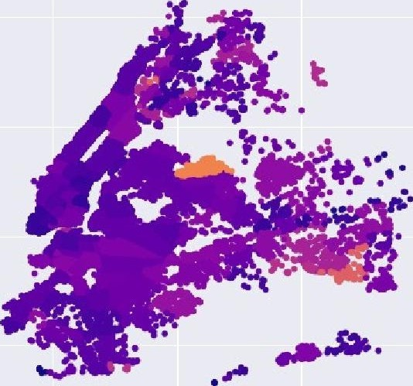

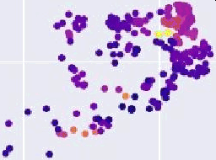
Find Best Location ListingPro/ o terv Location For
”Travelers and Hosts
Ave ra ge A +rb n b Rev +cms by Ne ig1 borhoods +r New *ork C +ty
40 5
OBSERVATIONS :-
I have attached a photo of this map because of some valuable insight. The neighborhoods near the airport in Queens would have a higher average number of reviews, as they are likely to attract a lot of tourists or visitors who are passing through the area. The proximity to the airport could make these neighborhoods a convenient and appealing place to stay for travelers for short-term stay.
There could also be other factors contributing to the high average number of reviews in these neighborhoods. For example, they may have a higher concentration of high-quality listings or attractions that attract more visitors and result in more reviews and Airport is key factor.

Slide 19
THANK
YOU

